Slide 1
Parallel Programming in Python – a very, very short introduction
Agenda
Computer architectures, data structures, and opportunities
Case 1 – computing a sparse distance matrix
Case 2 – computing the average of a large sample

Slide 2
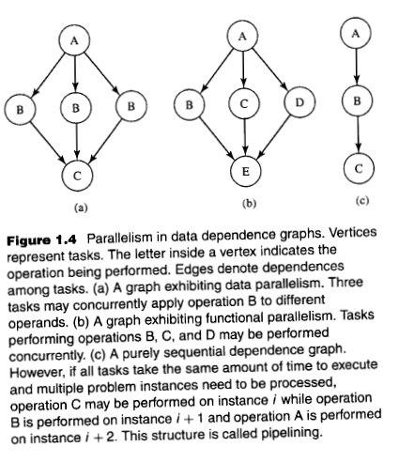
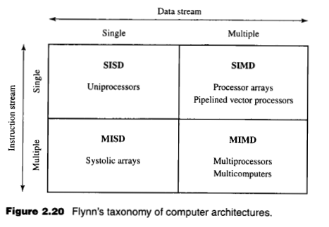
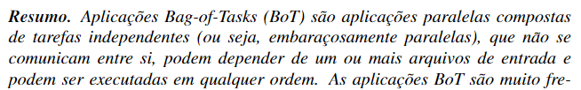


The scope of the technique that will be presented:

Slide 3

Case 1 – computing a sparse distance matrix

Slide 4
Case 1 - computing a sparse distance matrix, sequential scheme
k-dimensional vectors
v1
v2
v3
vk
v1
v1
v1
v1
v2
v2
v2
v3
v3
tasks
v2
v3
vk
v3
vk
vk
v1
v2
v3
vk
v1
0
Sequential execution, process P1
v2
0
v
distance matrix
v3
0
0
vk
v
0

Slide 5
Case 1 - computing a sparse distance matrix, parallel scheme
vectors
v1
v2
v3
vk
distance matrix
v1
v2
v3
vk
v1
v1
v1
v1
v2
v2
v2
v3
v3
v1
0
tasks
v2
v3
vk
v3
vk
vk
v2
0
v
v3
0
Parallel execution
process P1
Parallel execution
process P2
0
vk
v
0

Slide 6
Case 2 – computing the average of a large sample

Slide 7

Case 1 - computing the average of a very large sample
Attributes obtained from the same individual
(sample)
height
weight
Sequential execution, main core
BMI
$$BMI=\frac{weight}{{height}^{2}}$$

Slide 8
Case 1 - computing the average of a very large sample
Attributes obtained from the same individual
(sample)
height
weight
Parallel execution
core 1
Parallel execution
core 2
Parallel execution
core 3
Parallel execution
core 4
BMI
$$BMI=\frac{weight}{{height}^{2}}$$

Slide 9
Case 3 – TBD

Slide 10
To be resumed in a future meeting ;)

Slide 11
Parallel Programming in Python – a very, very short introduction
Thanks!

Slide 12
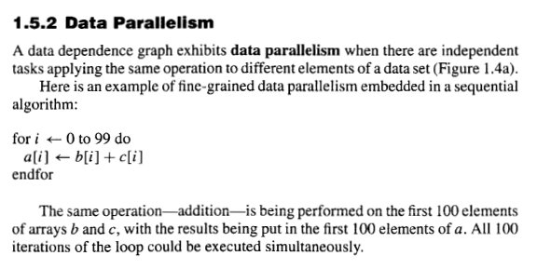
Bag of Tasks

Slide 13
